Slide 1
CEIS295 Module 2
Speed Test for LinkedList Data Structure

Slide 2
Rubric
Activity | Requirement(s) | Points
Develop Code to Test Algorithm Speed | LinkedListActualSpeed.py Code | 10
Screenshot to Demonstrate Working Application | Screenshot of running application showing your name and the current date | 10
Excel Table Showing Relevant Speeds | Table Showing Speeds | 10

Slide 3
LinkedListActualSpeed.py Python Code
Code: #Blake Reidinger
# Date 10/31/2023
from LinkedList import LinkedList
from Client import Client
from datetime import date
import time #Use this libary to time the code executions
import random # Use to generate random numbers
import sys # use to terminate the application early
# Display name and date in output
print("Name:", "Blake Reidinger")
print("Date:", date.today())
print()
#Create a list
clients = []
input_file_name = 'ClientData.csv'
with open(input_file_name) as infile:
for line in infile:
#split the line based on the commas
s = line.split(',')
client_id = int( s[0] ) #Convert the default string to an integer
f_name = s[1]
l_name = s[2]
phone = s[3]
email = s[4]
#Create a client object using data from the file
clt = Client(client_id, f_name, l_name, phone, email)
#Add the client object to the list
clients.append(clt)
#How many client objects do we have?
num_records = len(clients)
#Create an LinkedList object
my_linked_list = LinkedList()
# Scenario 1: Printer Queue or Call Queue
section_title = "Scenario: Printer Queue or Call Queue"
print(section_title)
print("-" * len(section_title))
#How long does it take to add the client recrods to the ArrayList?
start_time = time.time()
for i in range(num_records):
my_linked_list.add_last(clients[i])
end_time = time.time()
total_time = end_time - start_time
print("Seconds to add records: {:.6f}".format(total_time))
#How long does it take to remove records from the front of the LinkedList?
start_time = time.time()
for i in range(num_records):
my_linked_list.remove_first()
end_time= time.time()
total_time = end_time - start_time
print("Seconds to remove records from front: {}".format(total_time))
# Scenario 2: Customer Service Center
answer = input("Continue (y/n)? ")
if answer.lower() != "y":
sys.exit() #End application
section_title = "Scenario: Customer Service"
print(section_title)
print("-" * len(section_title))
# add clients to the LinkedList
for i in range(num_records):
my_linked_list.add_last(clients[i])
#How long does it take to randomly display 1000 records?
start_time = time.time()
for i in range(1000):
smallest_id = 100001
largest_id = smallest_id + num_records
random_num = random.randint(smallest_id, largest_id)
print( my_linked_list.search(Client(random_num)))
end_time = time.time()
total_time = end_time - start_time
print("Seconds to display random records: {:.6f}".format(total_time))
# Scenario 3: Call Center
answer = input("Continiue (y/n)? ")
if answer.lower() != "y":
sys.exit() #End application
section_title = "Scenario: Call Center"
print(section_title)
print("-" * len(section_title))
#How long does it take to add records, randomly display 1000 records
# and randomly remove 1000 records?
start_time = time.time()
# add records
current_id = 100001 + num_records + 1
for i in range(1000):
my_linked_list.add_last(Client(current_id))
current_id += 1
#Display random records
for i in range(1000):
smallest_id = 100001
largest_id = smallest_id + num_records
random_num = random.randint(smallest_id, largest_id)
print( my_linked_list.search(Client(random_num)))
#Remove randm records
for i in range(1000):
smallest_id = 100001
largest_id = smallest_id + num_records
random_num = random.randint(smallest_id, largest_id)
print( my_linked_list.remove(Client(random_num)))
end_time = time.time()
total_time = end_time - start_time
print("Seconds to add, display, and remove records: {:.6f}".format(total_time))
Paste your Python code. Include the following processes:
Read records into application
Test the following process speeds:
Add records to beginning of data structure
Add records to end of data structure
Add records to middle of data structure
Retrieve records from beginning of data structure
Retrieve records from end of data structure
Retrieve records from middle of data structure

Slide 4
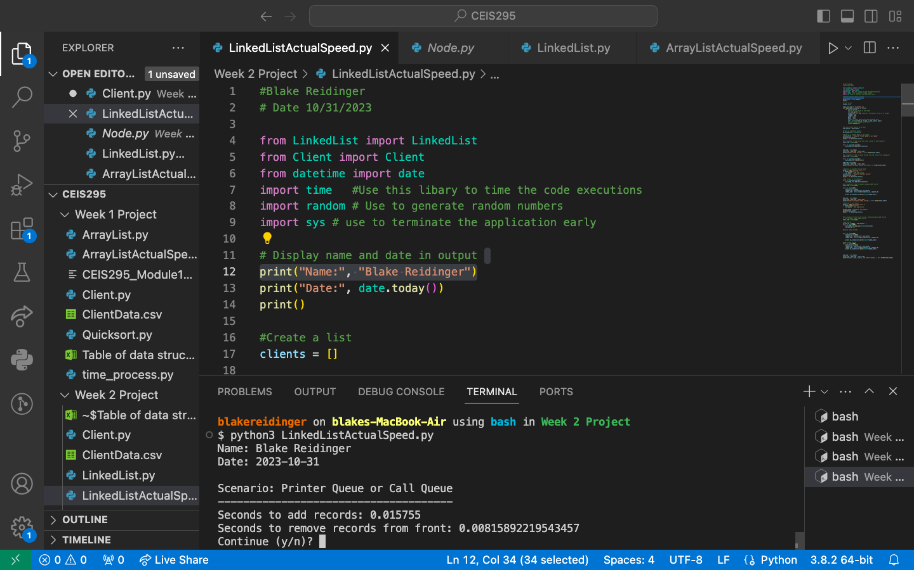

Slide 5
Table of Real - World speeds
 | ArrayList(Unsorted) | ArrayList(sorted data) | LinkedList
Scenario: Printer Queue or Call Queue or Service Queue
Add many records to end of data structure | 0.007257 | 0.010625 | 0.016092
Pull all records off front of data structure | 10.006087 | 10.596607 | 0.007404
Scenario: Customer Service Center
Display random records | 2.553499 | 0.033087 | 3.02127
Scenario: Call Center
Add some records, display random records, remove random records | 4.843064 | 3.802457 | 5.880396

